Slide 1





TextEvolve
Digitizing History with AI/OCR
Team Name
:
Dynamic Dreamers
NMNT ID
:
NMNTSTD7116020
College Name
:
Kathir College of Engineering

Slide 2
Problem Statement
Theme:
Artificial Intelligence
Problem Statement:
How might we develop an AI or OCR solution to digitize and convert handwritten, old registered documents into a readable and accessible format in regional languages, improving public access and readability of historical records? The solution should allow the output to be downloaded in various formats such as PDF and Word, enabling wider distribution and accessibility.

Slide 3
Existing System and Proposed System
Existing System:
Existing manual transcription methods are slow, costly, and error-prone.
Standard OCR models often struggle with accuracy for handwritten text, regional languages, and historical scripts.
Physical document degradation and limited accessibility are significant challenges.

Slide 4
Existing System and Proposed System
Proposed System:
An AI-driven OCR platform specifically designed for handwritten text and regional languages.
It utilizes a dual OCR approach:A custom Machine Learning (ML) model trained for specific scripts handles initial recognition.
Google OCR API is integrated for enhanced accuracy and corrections.
The platform aims to be fast, scalable, and user-friendly, offering real-time results and progress tracking.

Slide 5
References
Frontend: React Vite & Tailwind CSS for a responsive UI.
Backend: Python Flask for backend services and API integration.
Database: MongoDB for scalable document storage.
AI/ML: TensorFlow, PyTorch, Keras for the custom model; Google OCR API.
Programming Languages: Python, JavaScript.

Slide 6
Innovative and Unique Solution
Custom ML Model:
Designed specifically for handwritten and regional scripts.
Improves recognition accuracy over time with continuous training.
Dual OCR Integration:
Custom model for initial recognition.
Google OCR API for enhanced accuracy and corrections.

Slide 7
Innovative and Unique Solution
Language Versatility:
Language Versatility
Robust Data Handling:
Python Flask backend paired with MongoDB ensures scalable and secure storage.
User-Friendly Platform:
Modern UI for easy upload and retrieval.
Real-time results and progress tracking.

Slide 8




















Technology Stack
Programming Languages
Database & Deployment
Frameworks & Libraries
Development Tools

Slide 9


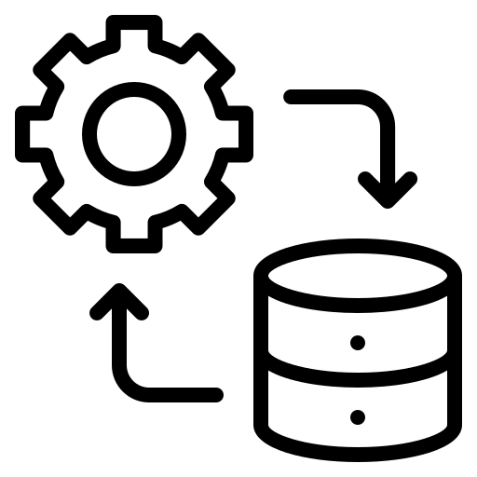

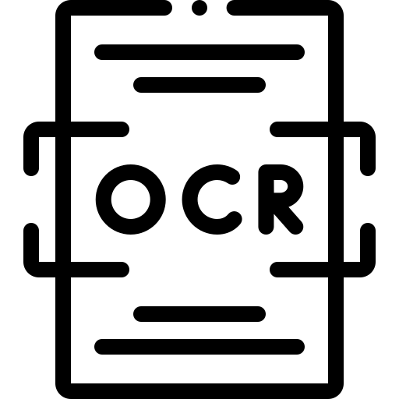
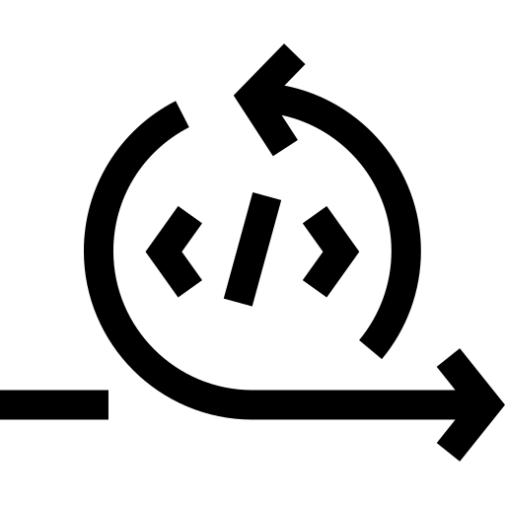






System Architecture & Workflow
Model initial conversion
User Access
Save successful?
Data Integration
Pre-processing
OCR Conversion
Re-run ML model
Post-Processing
Storage
Results
Error
OCR API
Notify error

Slide 10
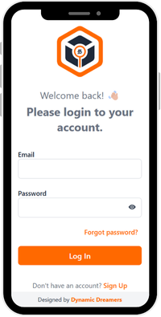
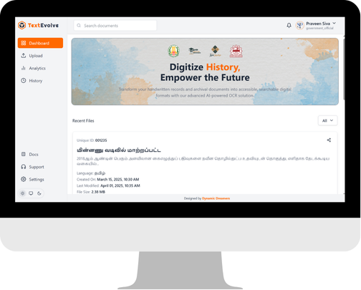
Demo / Sample Results
https://squadofcreators.github.io/TextEvolve

Slide 11
Challenges
Degradation:
Physical documents deteriorate over time.
Inaccessibility:
Limited access to rare or regional texts.
Handwriting Variability:
Handwritten texts present difficulties in standard OCR processing.
Language Barriers:
Many OCR solutions are not optimized for regional languages.

Slide 12
Benefits & Impact
Cultural Preservation: Safeguard historical documents for future generations.
Enhanced Accessibility: Allow researchers, educators, and the public to easily access digitized content.
Improved Research: Facilitate the study of regional languages and historical texts.
Scalability: A robust system that can grow to handle vast archives.

Slide 13
Conclusion
TextEVolve is an AI-driven solution that digitizes handwritten historical documents with high accuracy using a custom ML model and Google OCR API.
By combining innovation with technology, it preserves cultural heritage, enhances accessibility, and supports research — ensuring valuable historical knowledge is safeguarded for future generations.

Slide 14
Q&A
?
Ask Questions

Slide 15
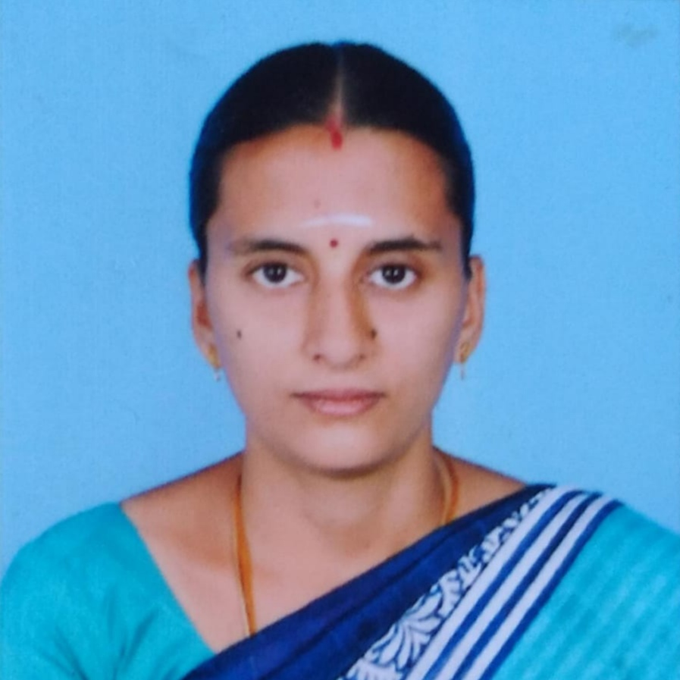
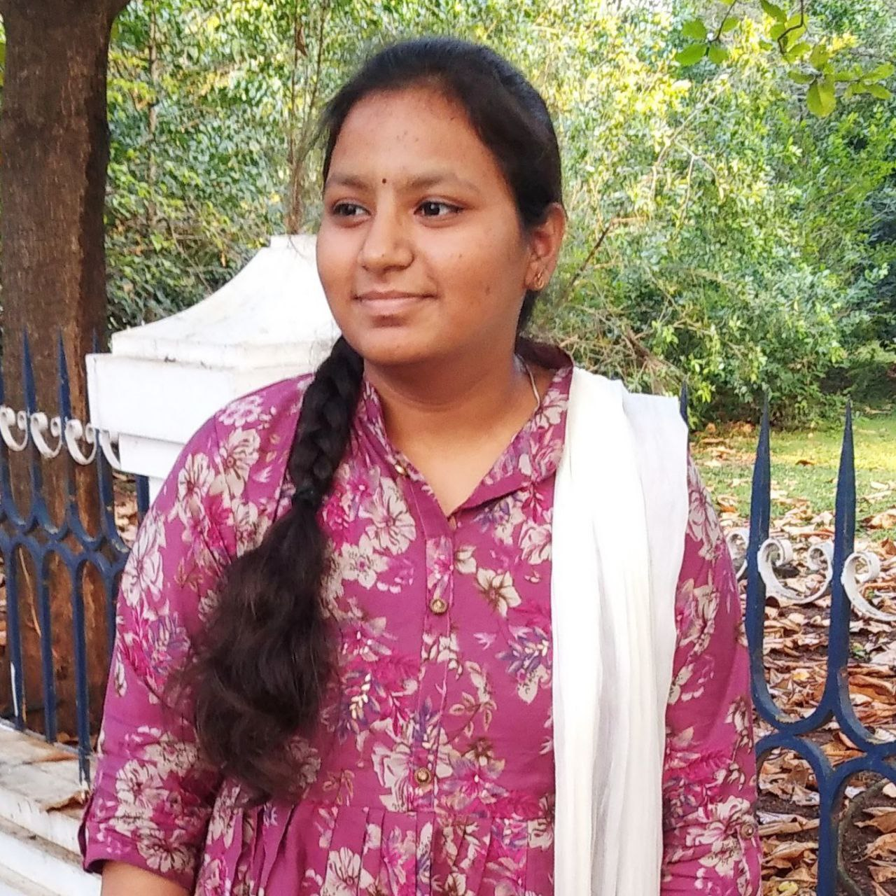



Our Team
Mrs. Kavitha M
Yuva Nandhini M
Faculty Guide
AI/ML Developer
Praveenkumar S
Sibi Siddharth S
Uma Maheswari P
AI/MERN Developer
AI/MERN Developer
AI/ML Developer

Slide 16
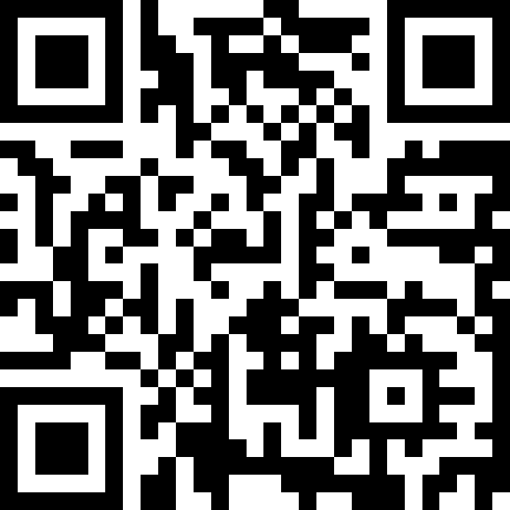
Live Project
Preserving the Past, Empowering the Future

